Slide 1
Leslie McMurchie

Slide 2
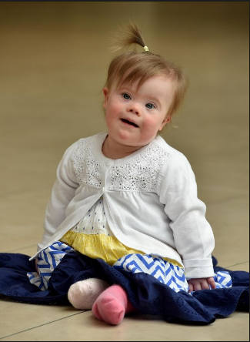
It can be difficult to learn that your child has special needs.

Slide 3
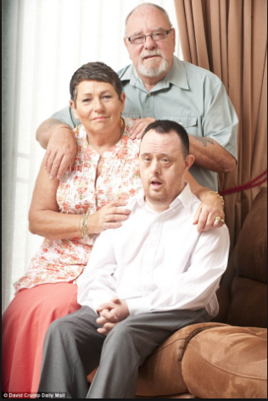
How can we help aging parents rest assured that their adult children with disabilities will be cared for when they’re no longer here?

Slide 4
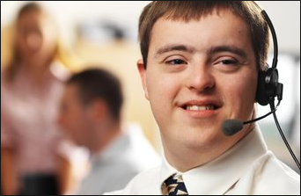
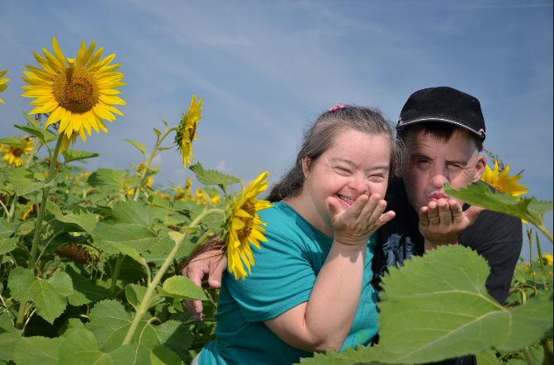
How can we do this while also recognizing that adults with special needs can contribute to society and that they also have hopes and dreams of their own?

